Slide 1
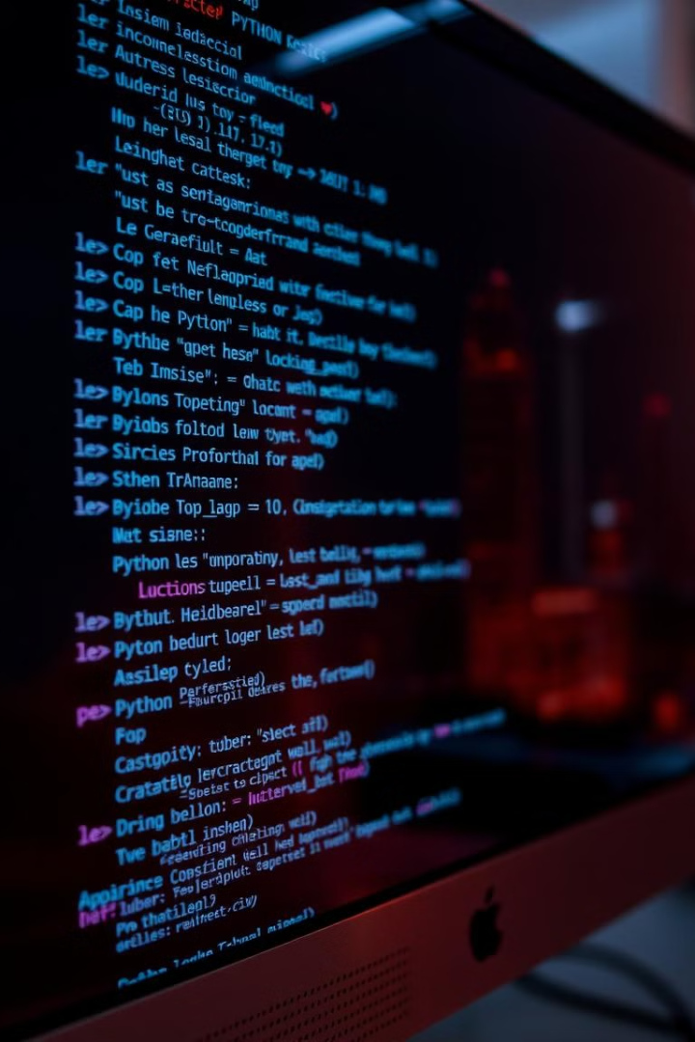
Assignment: Mastering Functions & Classes in Python
This assignment will test your knowledge of Python functions and classes. You will write functions to perform calculations and process data. You will also define classes with attributes, methods, and inheritance.
NK
by Naveen K

Slide 2
Part 1: Function Fundamentals
Objective
Task 2
Demonstrate proficiency in defining and using Python functions.
Create a function process_list(data, operation) that processes a list of numbers using a given operation.
Task 1
Include error handling for non-numerical data.
Write a function calculate_area(shape, \*\*kwargs) that calculates the area of a rectangle or a circle.

Slide 3
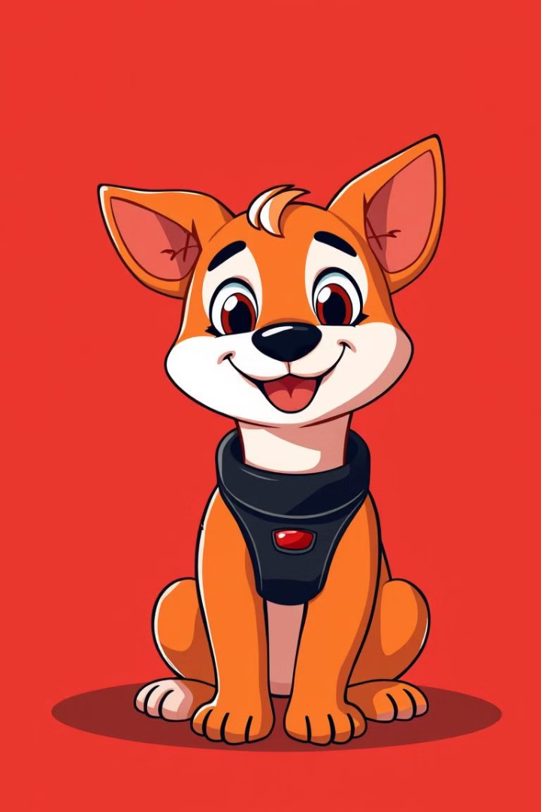
Part 2: Introduction to Classes
Objective
Task 1
Understand and implement basic Python classes.
Define a class Dog with attributes: name, breed, and age. Implement a bark() and human_age() method.
Task 2
Create two instances of the Dog class and print their attributes. Show how to call the bark() and human_age() methods.

Slide 4
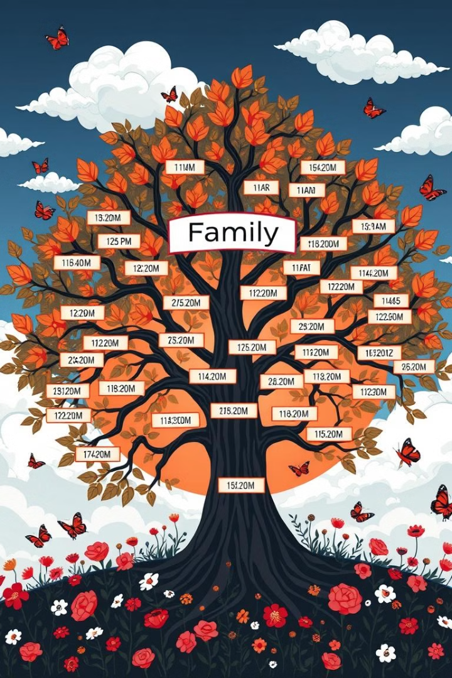



Part 3: Class Inheritance
Employee Class
Create a base class Employee with attributes name, employee_id, and salary.
Manager Class
Create a subclass Manager that inherits from Employee. Add a department attribute.
Override
Override the give_raise() method to give managers a 10% higher raise.

Slide 5



Part 4: Class & Static Methods
get_dog_count()
2
Implement a class method get_dog_count() that returns the current value of dog_count.
dog_count
1
Add a class attribute dog_count initialized to 0.
is_valid_age(age)
Implement a static method is_valid_age(age) that returns True if the age is valid.
3

Slide 6
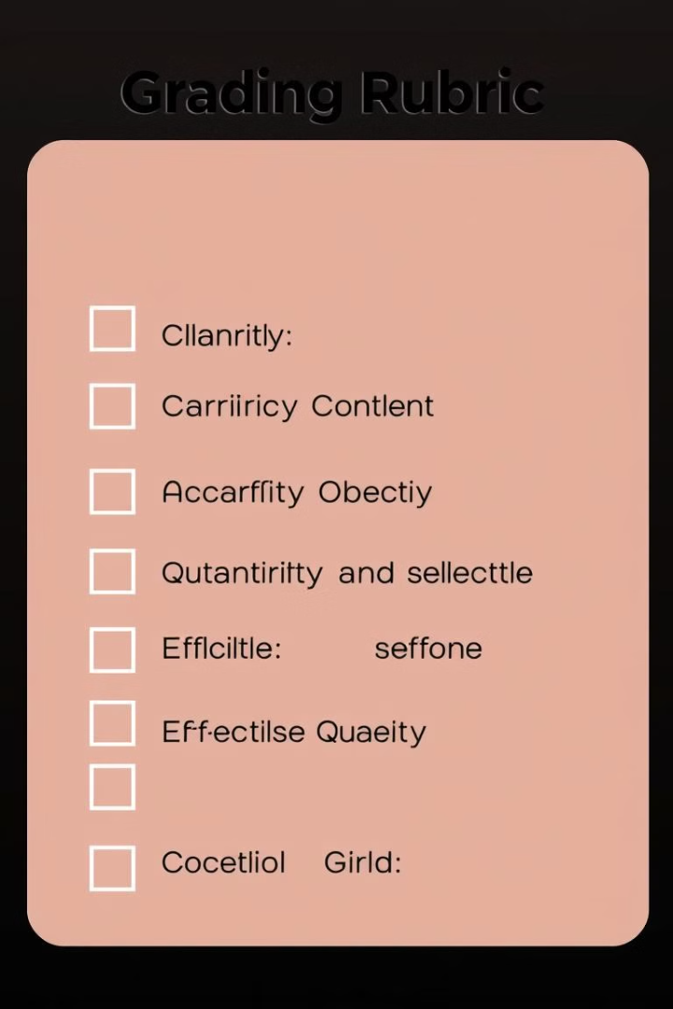
Grading Rubric
Function Fundamentals
25 points
Introduction to Classes
25 points
Class Inheritance
25 points
Class Methods/Static Methods
25 points
Each part of the assignment is worth 25 points. Refer to the detailed rubric for specific grading criteria.

Slide 7
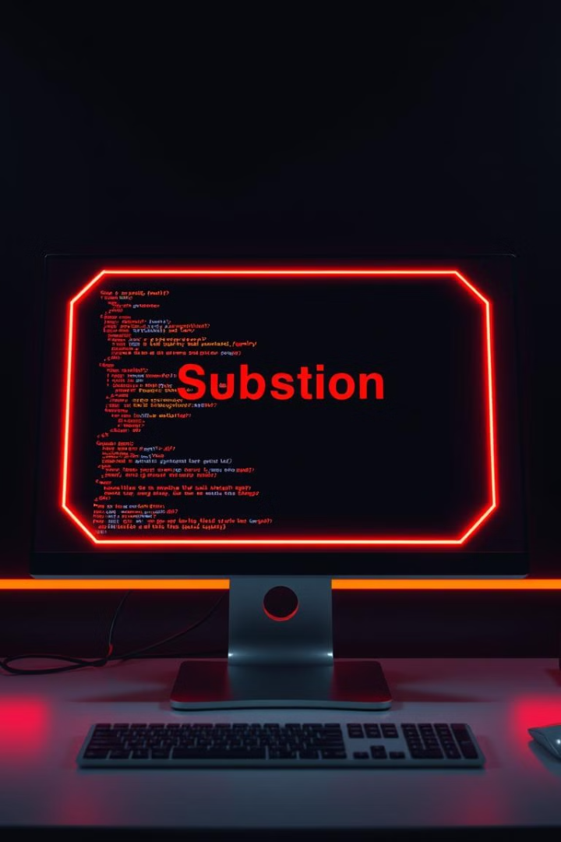
Submission Instructions
1
Single Python File
2
Comments
Create a single Python file (.py) containing all code.
Include comments to explain the code logic.
3
Online Submission
Submit the file through the online learning platform by the deadline.

Slide 8




Resources and Support
Python Docs
Online Tutorials
Instructor Office Hours
Utilize the available resources to help you succeed. Refer to Python documentation, online tutorials, and instructor office hours.

